Slide 1
ASA
Harrison CABLE

Slide 2

Purpose/legal
Advertising Standards Authority
It is an independent company that focuses on regulating all advertising across all platforms.
They focus on all aspects like ethical issues, political messages, misleading content, inappropriate targeting.
However they cannot independently take legal action against a company, but all their information can be relayed onto court if applicable for punishment.

Slide 3
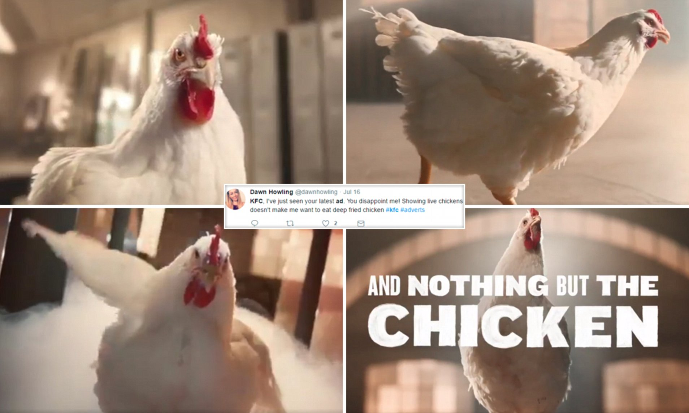
Controversies
KFC released an advert featuring a dancing chicken to upbeat rap music.
This received 755 complaints due to it being taken as disrespectable towards chickens and distressing vegans and vegetarians.
Also it was misleading for children as it portrayed an image that chickens where happy (dancing) before going for slaughter.
ASA stated that it was unlikely that the advert caused widespread offence as there was no explicit/obvious scenes or references to animal slaughter.

