Slide 1
BBFC
Harrison cable

Slide 2
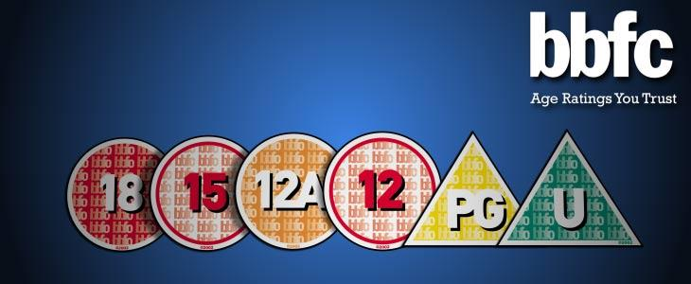
Purpose and legal
British board of film classification
Provides age rating, national (UK) classification and censorship for all things broadcasted at cinemas.
They are an independent company, this means that they are non-profit.
Trading Standards and law enforcement have the ability to seize videos (DVD’s etc) then the BBFC have a role to provide evidence to allows convictions of under age viewership.
One the BBFC viewers give your film a rating a certificate of age rating is given to the film, then this has to be put on the film. However local authorities have the power to overturn age ratings if they feel that it is applicable.

Slide 3
Case studies
Batman:
In 1982 there was only 4 classifications, U, PG, 15, 18, they needed to introduce a medium between PG and 15, due to many films complying with what was no socially accepted as viewable for 12 year olds but due to the gap from PG to 15 this was not able to occur.
So in 1989 they added a 12 rating, this was first given to Batman, this is because the Joker was going to be to scary for younger audiences but within the age of 12+ was deemed acceptable as the sinister tone of him would be understandable for 12+ year olds, also the BBFC saw this age demographic to be a suitable audience for Batman so it was given a 12.

Slide 4
Controversies
The Dark Knight:
Previous Batman films received a 12A rating, therefore the synergy carried onto The Dark Knight, however vast complaints where received due to the high level of violence, in particular ‘the pencil scene’ this consists of The Joker pushing someone’s head aggressively down into an upright pencil, this was seen as too violent from many parents for it being classified as 12A.
However, when slowing down the scene you can clearly see that you cannot see any physical impact, it just gets strongly inferred due to the rapid process of which it happens.
BBFC stayed to there initial rating and kept it as a 12A as in the guidelines it does state that you need to see the contact for it to be portrayed as violent enough for a 15.

