Slide 1
IPSO
Harrison cable

Slide 2
Purpose and legal
Independent Press Standards Organisation
It’s an independent regulator on print releases, newspaper, magazine.
They take action to any unethical actions from these forms of broadcasting.
They don’t have many legal procedures that they an take action upon but they focus on informing government to then take action when necessary.
This is when issues like accuracy isn’t there, invasion of privacy, hostility towards people.

Slide 3
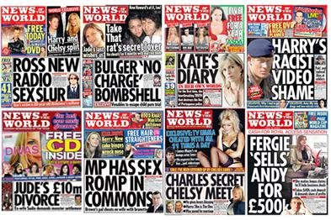
Case studies/controversies
In 2011 the News International phone hacking scandal:
It became apparent when the parents of Mille Downers want missing, the newspapers new the last road she was on, and this information was breached through hacking that newspapers did.
This led to the 2 companies involved being removed and journalist being sentenced to prison (one was News of the World)
This shows that a mass breach of security onto all people, royalty, famous etc led to major consequences and punishment.

